Slide 1
CSC 578 Neural Networks and Deep Learning
Fall 2018/19
4. Deep Neural Networks
(Some figures adapted from NNDL book)

Slide 2
Various Approaches to Improve Neural Networks
Deep Neural Networks
Concepts, Principles
Challenges in Deep Neural Networks
Overfitting
Long computation time
Vanishing gradient
Hyper-parameters tuning

Slide 3
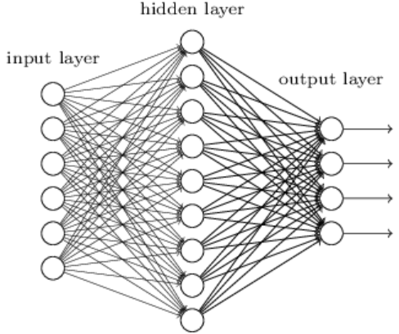
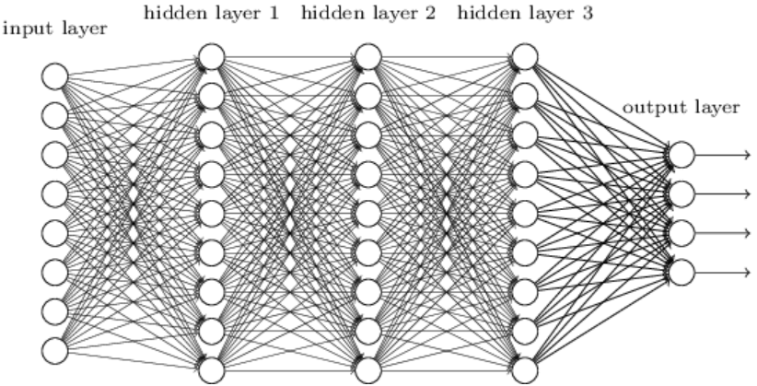
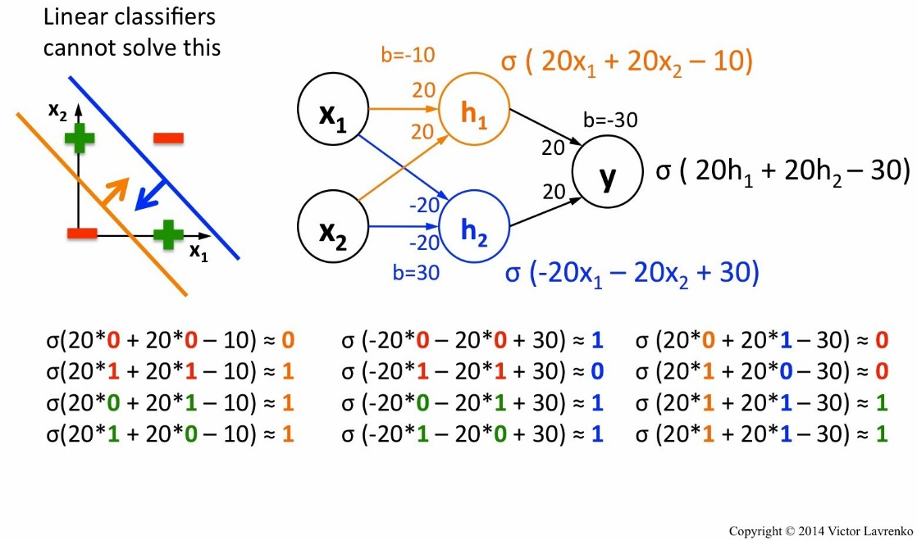
1 Deep Neural Networks
Single vs. Multilayer Neural networks:
Deep networks (with larger number of layers) are generally more expressive/powerful.

Slide 4
2 Challenges in Deep Networks
Though powerful, deep neural networks have many challenges, especially in training. Notable ones are:
Overfitting
Long computation time
Vanishing Gradient
Too many hyper-parameters to tune

Slide 5
2.1 Overfitting
Deep neural networks are (naturally) prone to overfitting due to the very large number of nodes/variables and parameters (i.e., degree of freedom).
To overcome overfitting, several techniques have bee proposed including:
Regularization (e.g. L2, L1)
Dropout
Early stopping
Sampling and/or clipping of training data

Slide 6
2.2 Computation Time
In addition to the large network size (the number of layers and units per layer), which takes time to process, deep neural networks usually have many hyper-parameters (e.g. the learning rate η and the regularization parameter λ).
Poor parameter values (including initial weights) could make the computation even longer, preventing the weights to converge.
There are ways to speed up the network (learning):
Mini-batching
Early stopping
Better parameter selection
Utilize hardware support, e.g. GPU

Slide 7
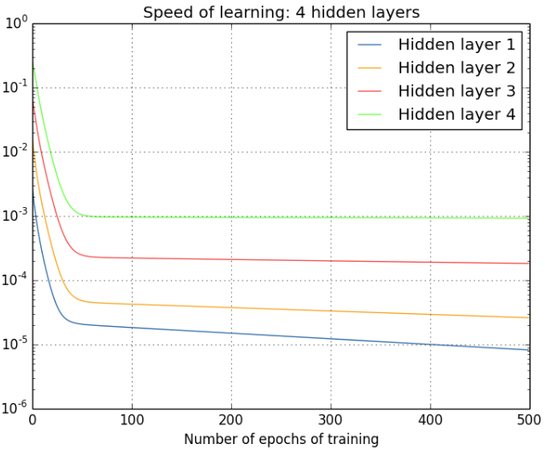
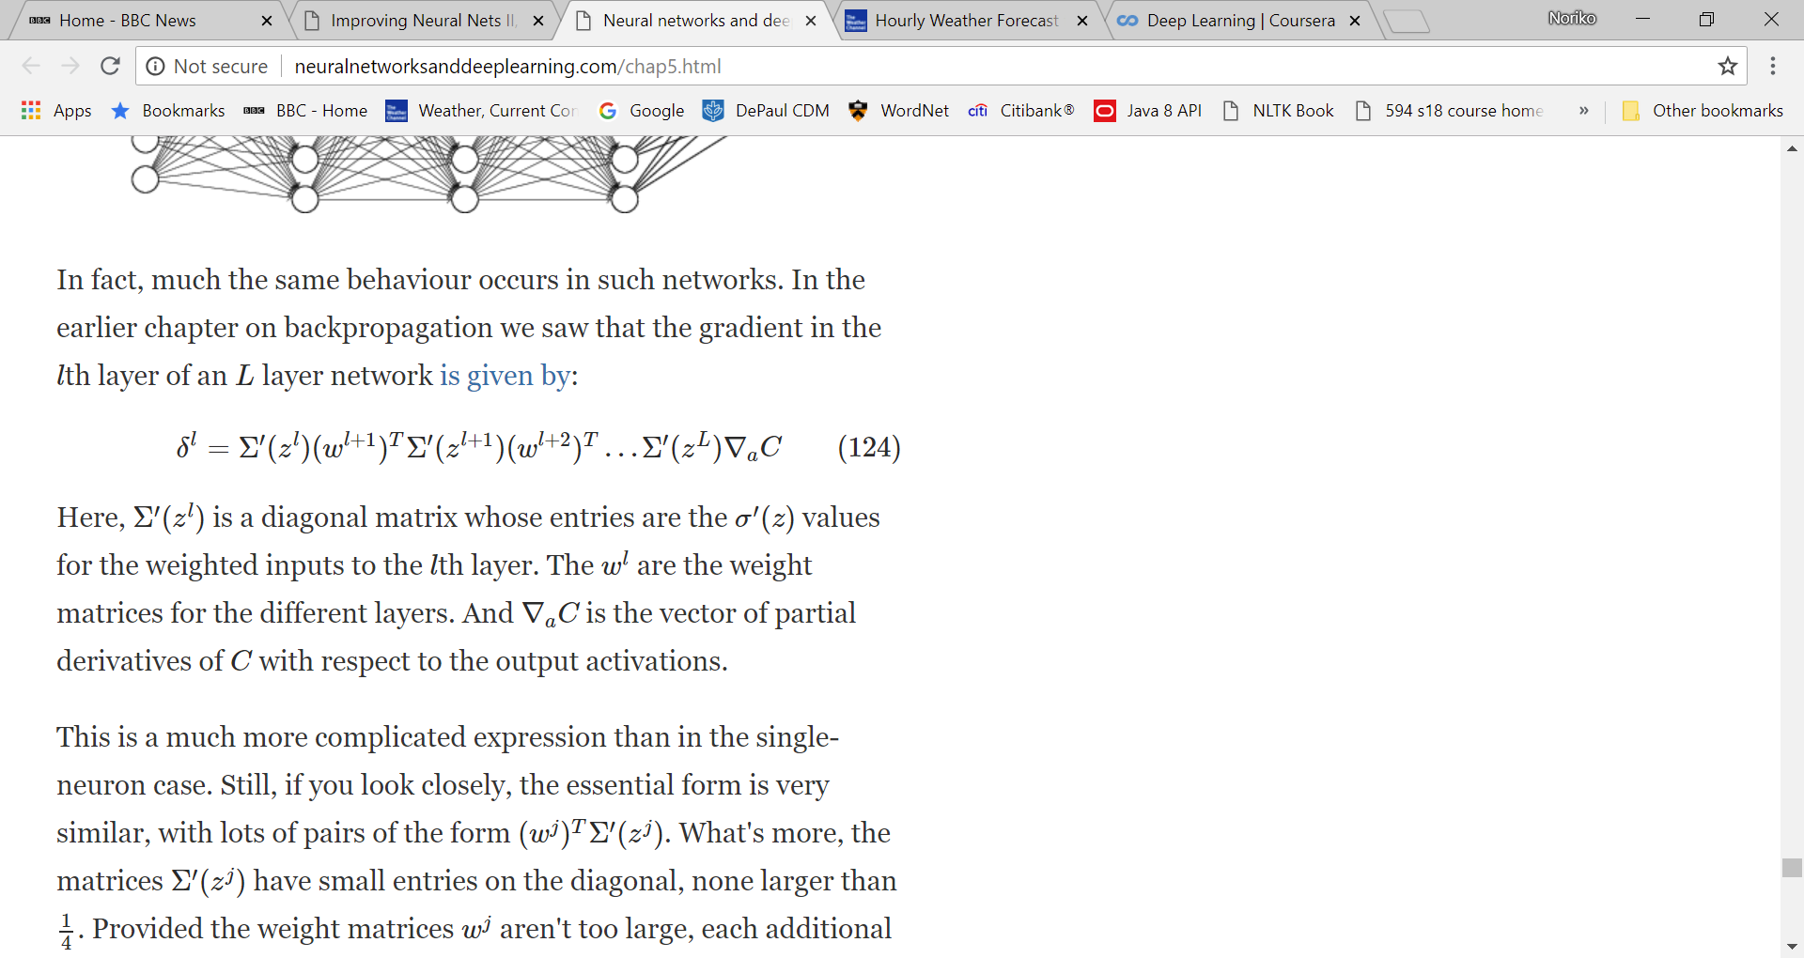
2.3 Vanishing Gradient
Observation: Early hidden layers learn much slowly than later hidden layers.
Reason: In BP, gradient is propagated backwards from the output layer to the input layer so the early layers receive fraction of the gradient (i.e., vanishing gradient), although in some cases, gradient gets larger as it is propagated backwards (i.e., exploding gradient). In general, gradient is unstable in deep networks.
Gradient in the lth layer is

Slide 8
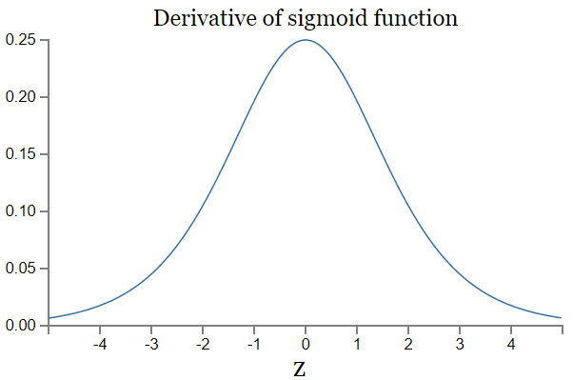
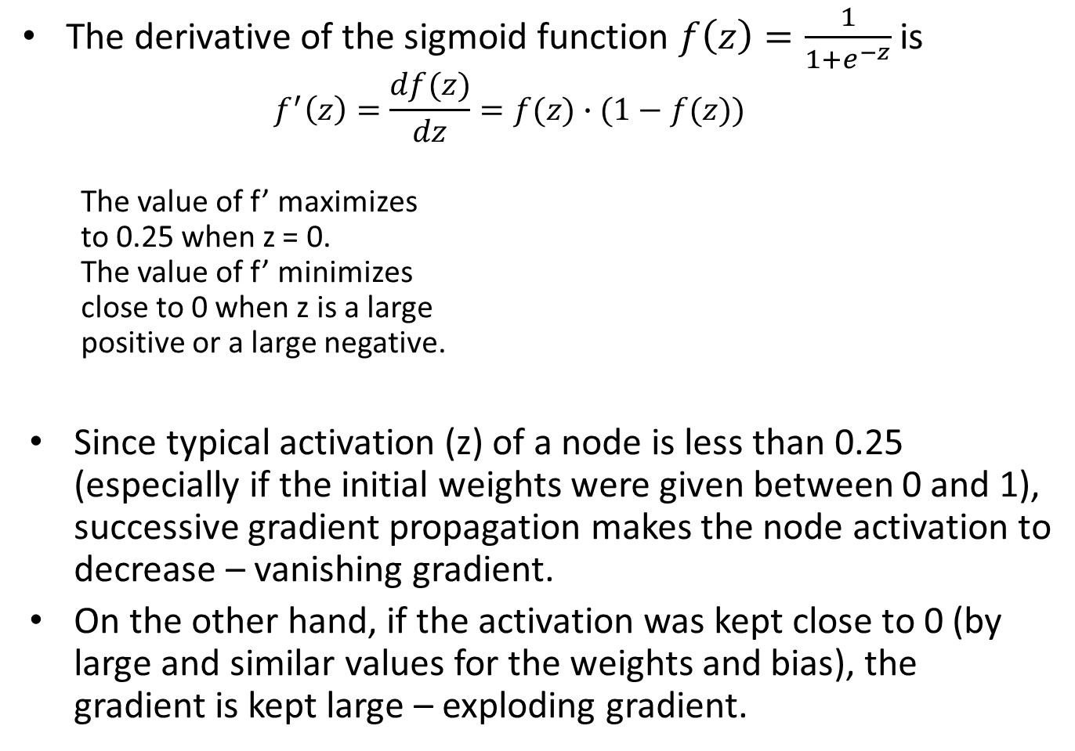
The derivative of the sigmoid function $f\left(z\right)=\frac{1}{1+e^{−z}}$ is
$$f^{′}\left(z\right)=\frac{df(z)}{dz}=f(z)∙(1−f(z))$$
The value of f’ maximizes to 0.25 when z = 0. The value of f’ minimizes close to 0 when z is a large positive or a large negative.
Since typical activation (z) of a node is less than 0.25 (especially if the initial weights were given between 0 and 1), successive gradient propagation makes the node activation to decrease – vanishing gradient.
On the other hand, if the activation was kept close to 0 (by large and similar values for the weights and bias), the gradient is kept large – exploding gradient.

Slide 9
With deep networks with gradient-based cost minimization, vanishing gradient is very difficult to circumvent, unless weights and biases somehow balance out (luckily).
Some techniques to overcome vanishing gradient:
Cross-Entropy cost function
Regularization

Slide 10
2.4 Hyper-Parameter Tuning
From NNDL Ch. 3:
Strip the problem down
Reduce the data (i.e., simplify the problem)
Start with a simple network (i.e., simplify the architecture)
Speed up testing by monitoring performance frequently
Try rough variations of parameters
Find a good threshold for learning rate
Stop training when performance is good (or shows no improvement)
Adaptive learning rate schedule
Several algorithms have been applied to systematically search for the optimal hyper-parameter values.
Grid search
Optimization techniques such as Monte Carlo and Genetic Algorithms

